Slide 1
BLOCKCHAIN BASED VOTING WEBSITE:
4nm18is044 H SWASTHIK SOMAYAJI
4nm18is039 DHANRAJ
4nm18is025 BALEBAIL VARUN ACHARYA

Slide 2
CONTENT
Introduction
Tools
Purpose
Implementation
Conclusion
References

Slide 3
IntroDUCTION
Normally when you interact with a web application, you use a web browser to connect to a central server over a network.
All the code of this web application lives on this central server, and all the data lives in a central database.
Anytime you transact with your application, must communicate with this central server on the web.
The data on the database could be changed: it could be counted more than once, or removed entirely.
The source code on the web server could also be changed at any time.

Slide 4
PURPOSE
Instead of a centralized database, all the transaction data that is shared across the nodes in the blockchain is contained in bundles of records called blocks, which are chained together to create the public ledger.
This public ledger represents all the data in the blockchain.
All the data in the public ledger is secured by cryptographic hashing, and validated by a consensus algorithm.
Nodes on the network participate to ensure that all copies of the data distributed across the network are the same.
Building our voting application on the blockchain, because we want to ensure that our vote was counted, and that it did not change.

Slide 5
TOOLS
NodeJS: Node.js is an open source server environment.Node.js uses JavaScript on the server.
Truffle Framework: Truffle framework is designed for the smart contract developer to deploy and test their contracts using some basic commands.
Ganache: Ganache is used for setting up a personal Ethereum Blockchain for testing your Solidity contracts.
Metamask Extenstion :Metamask is a cryptocurrency e-wallet that can be installed on any web browser as an extension.
Visual Studio Code(or any editor) with ethereaum package control: Blockchain Development Kit for Ethereum v1.6.2 Microsoft .

Slide 6
IMPLEMENTATION
Solidity allows us to create our own structure types as we've done for our candidate here.
The next thing we need is a place to store the candidates. We need a place to store one of the structure types that we've just created. We can do this with a Solidity mapping.
Now we can add two candidates to our election by calling the "addCandidate" function twice inside the constructor function.
Migrate contract using appropriate command. Make sure you have Ganache running first.

Slide 7
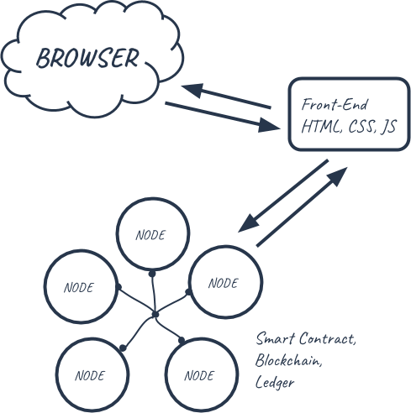
implementation
Start building out the client-side application that will talk to our smart contract.
Set up web3: web3.js is a javascript library that allows our client-side application to talk to the blockchain.
View the client-side application in the browser.
Start your development server from the command line like this: npm run dev
Then connect to metamask and perform voting.

Slide 8
Conclusion
Now we can vote on your client-side application, and watch the votes recorded in real time.
Building applications on Ethereum is pretty similar to a regular application calling a backend service.
There can be a future enhancement by adding fingerprint,cornea detection.
This will make voting system more secure and simpler.

Slide 9
THANK YOU

